Slide 1
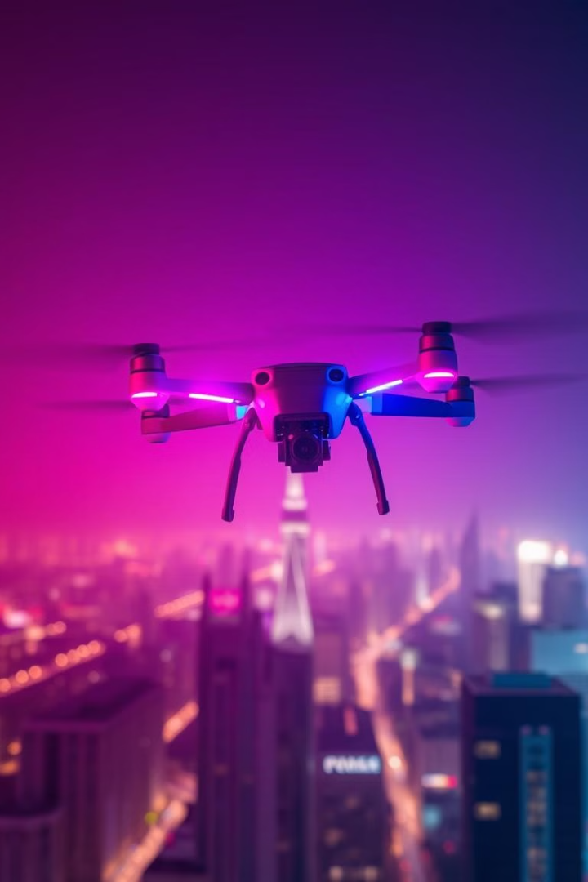
Drone System for Emergency Response
This Project outlines an innovative project using AI-powered drones to enhance emergency response and disaster management. Our goal is to develop a system that can rapidly identify threats, generate alerts, and deliver critical payloads, ultimately saving lives and improving safety for first responders.
--- Aiman Zareen

Slide 2
Business Case: Emergency Response Needs
Traditional Challenges
Drone-Enabled Solutions
Limited situational awareness, slow response times, and risks to personnel are common in emergency situations.
Drones offer enhanced situational awareness, faster response, and reduced risk to human responders.
The lack of real-time information and rapid deployment often hinders effective response efforts.
Their ability to access hard-to-reach areas and deliver critical payloads can drastically improve response outcomes.

Slide 3
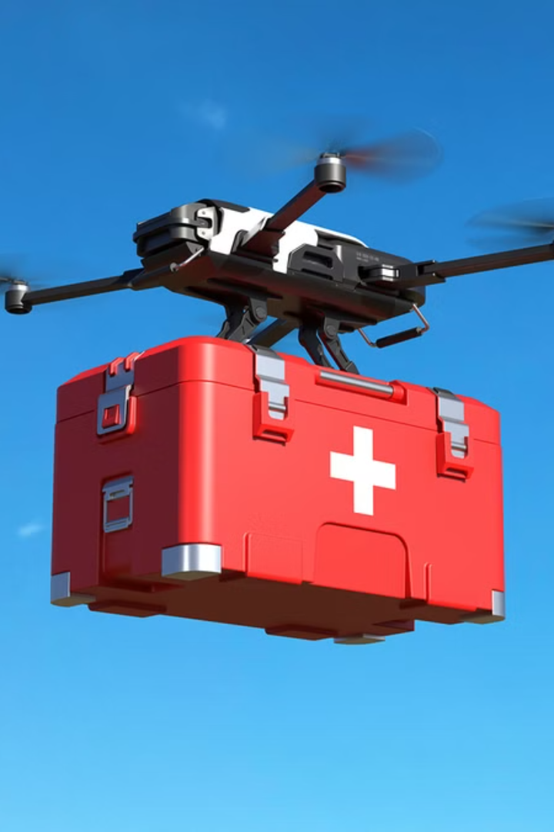
Target End Users: Emergency Response
First Responders
Emergency Service Providers
Police officers, firefighters, and paramedics are at the front lines of emergencies, facing high-risk situations.
Agencies like fire departments, police departments, and ambulance services rely on coordinated response efforts.
Disaster Relief Agencies
Organizations like the Red Cross and FEMA respond to large-scale disasters and provide crucial aid to affected communities.

Slide 4
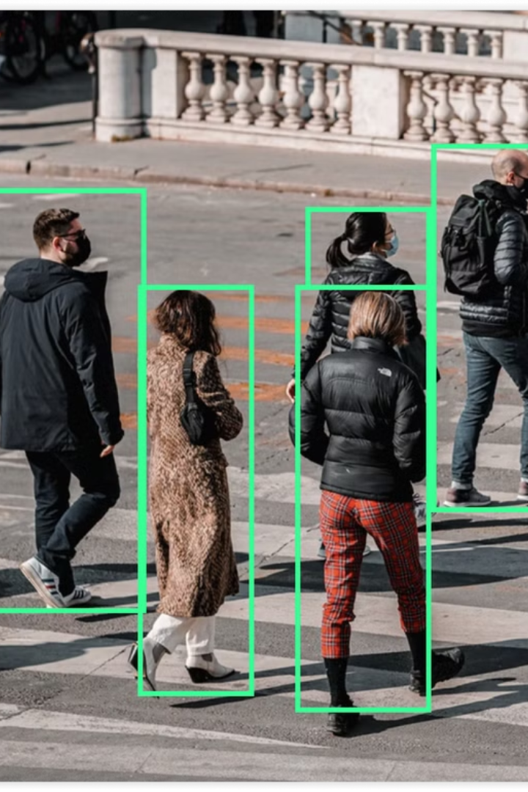



Key Features: Drone System
Real-time Human Detection
The system utilizes advanced computer vision algorithms to identify and track objects of interest in real-time, providing critical situational awareness.
Automated Alarm Generation
Once a threat is detected, the system automatically generates alerts, notifying relevant personnel and enabling rapid response.
Precision Payload Delivery
Drones are equipped to deliver essential payloads, such as medical supplies, communication equipment, or other critical resources, directly to the target location.

Slide 5
System Architecture: Integrated Technologies
Computer Vision
Drone Integration
Real-time Simulation
The system relies on advanced computer vision algorithms to identify and track objects in real-time, enabling swift threat detection and analysis.
Drones are seamlessly integrated into the system, acting as mobile platforms for data collection, threat assessment, and payload delivery.
Real-time simulation plays a crucial role, allowing the system to predict potential scenarios, optimize response strategies, and train AI models.

Slide 6
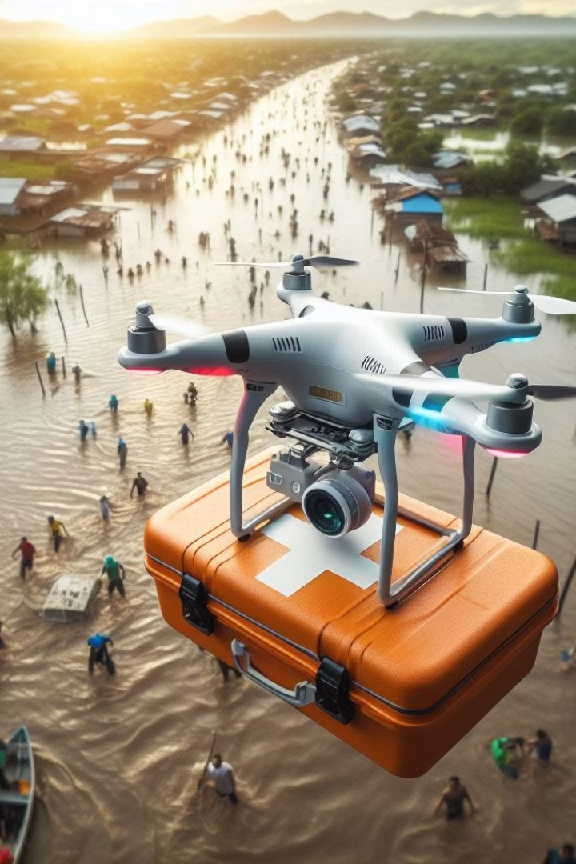
Operational Workflow: Automated Drone Response
1
Monitoring
The system continuously monitors the environment using sensors and cameras on the drones, collecting real-time data.
2
Threat Identification
AI algorithms analyze the collected data, identifying potential threats or emergencies based on pre-defined criteria.
3
Automated Response
Upon threat confirmation, the system automatically triggers a response, deploying drones to the affected area.

Slide 7



Expected Benefits: Enhanced Emergency Response
Saving Lives
1
Faster response times and more efficient resource deployment result in saving more lives.
Improved Safety
2
Reduced risk to human personnel by automating dangerous tasks.
Enhanced Efficiency
3
Increased situational awareness and faster response lead to greater efficiency.

